Slide 1
Credit Dataset
Denzel See DAAA2A07 2222840

Slide 2
Objective
To build a model to predict the whether the customer defaults or do not default
(Default means to the customer will not pay their bill)

Slide 3
Data visualization + cleaning

Slide 4
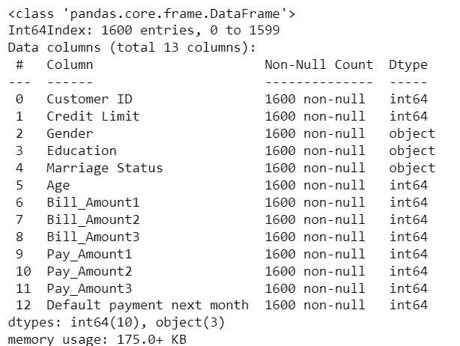
Printing Data Information
I used .info to print out the dataset’s information

Slide 5
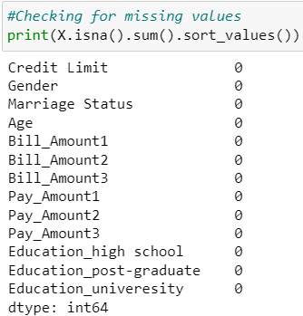
Checking for Nulls
I used this code to check the dataset for any nulls values.

Slide 6
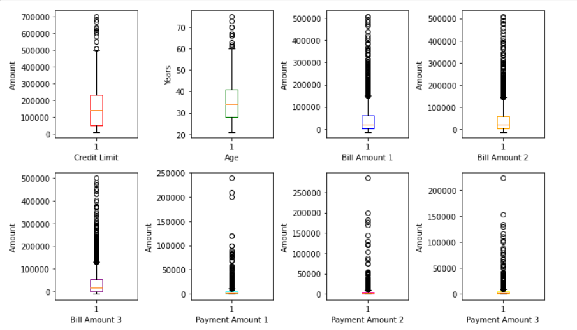
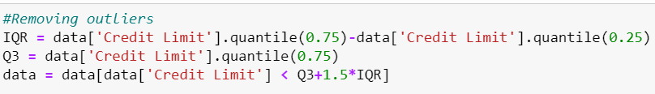
Checking for outliers
I plotted boxplots to check for outliers.
I then removed the outliers by deciding a range of Q3+1.5*IQR and removing any data about that threshold

Slide 7
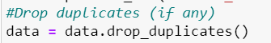
Removing any duplicates
I also drop any duplicates in the dataset if there is any

Slide 8
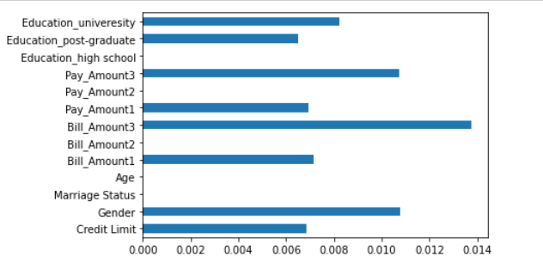
Feature importance graph
This graph determines the importance of features however I did not take it too seriously.

Slide 9
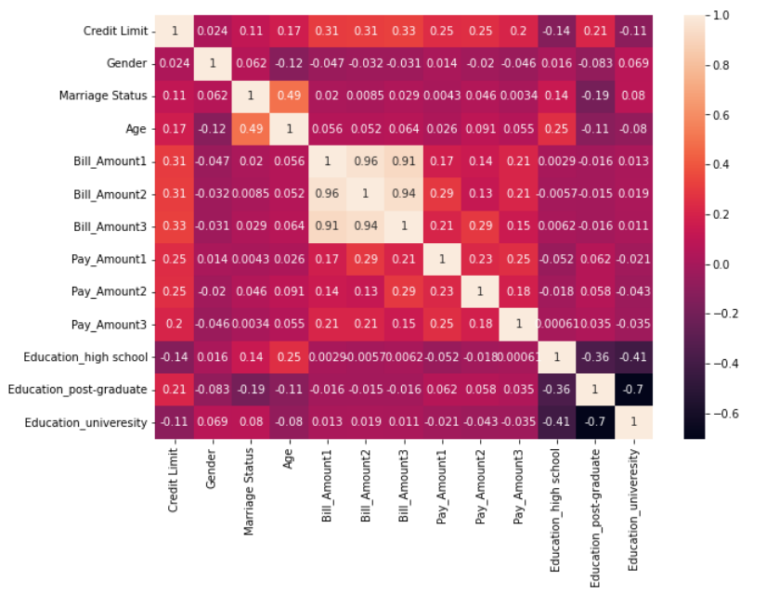
Correlation heatmap
This is a correlation heatmap that I used to see the correlation between features.
I removed features that have a high correlation with one another such as Bill_Amount2 to prevent multicollinearity

Slide 10
Feature selection

Slide 11
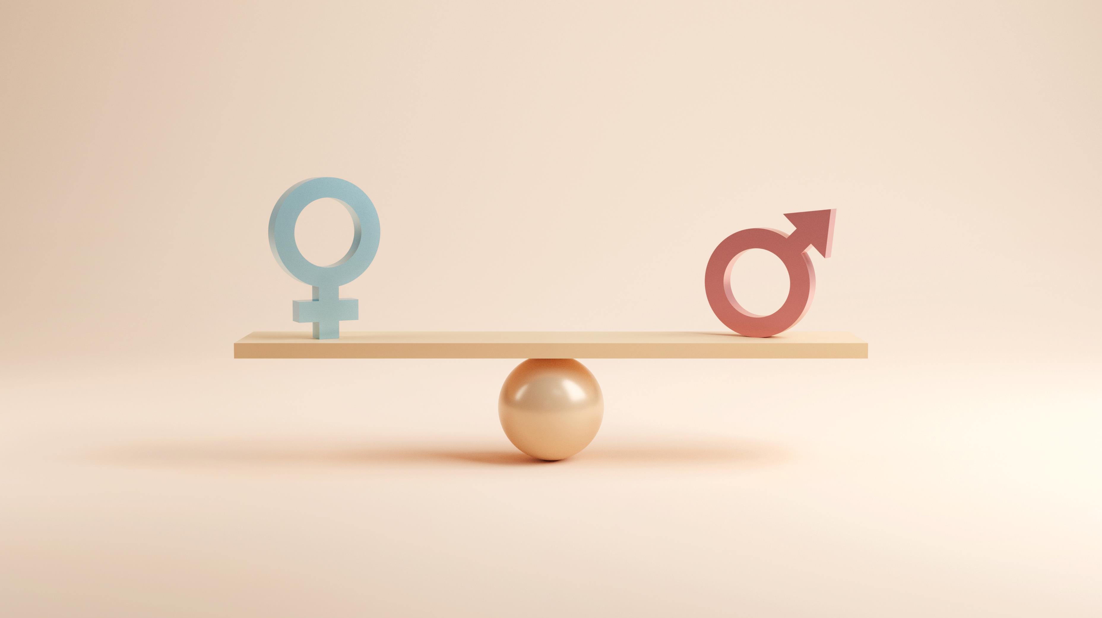
Gender
A study says that women tend to have more intensive credit usage, longer credit history, higher total debt outstanding, greater revolving credit utilization rates and higher instalment loan balances. This shows different genders have different tendencies which can play a role in their credit profile. Thus, I decided to keep the Gender column

Slide 12

Education
Education does not directly affect your credit score, but student loans can be a factor in whether the customer is able to pay of their loans in time. Thus, I kept the Education column.

Slide 13

Credit Limit
In order to increase your credit limit, you will need to be able to have a high creditworthiness which means you need to pay off your bills on time. Thus, higher credit limit will mean you are more likely to pay your bills on time. Hence, I decided to keep Credit Limit

Slide 14

Marriage Status
Marrying a person with a bad credit history won't affect your own credit record and will not affect your own credit score. Thus, I decided to drop Marriage Status

Slide 15

Age
A study states: “There seems to be an association of declining defaults as one progresses from the age of low 20s to early 30s and then there is a slow but steady increase of default rates from people aged in the early 30s to people aged in the early 50s.“ Thus I decided to keep Age

Slide 16

Payment History
Payment history is the most important feature when looking at the likelihood of whether the customer will default or not as it shows that history of the customers which can determine the pattern and habits of whether they will default or not. Thus I decided to keep Bill_Amount and Pay_Amount

Slide 17
Selecting Columns
I decided to drop Education_post-graduate, Bill_Amount2 and Bill_Amount3 on top of Marriage Status as they have a strong linear relationship with other variables. Thus, I dropped them to prevent multicollinearity.

Slide 18
Train test Split
I used the train_test_split code to split my code into two parts.
80% of the data will go into train where it will be used to train my model and 20% will go into test where it will be used to test my trained model.
I also stratified it so that the distribution between the train and the test will be about the same.

Slide 19
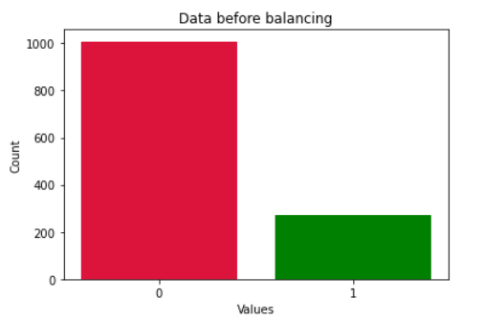
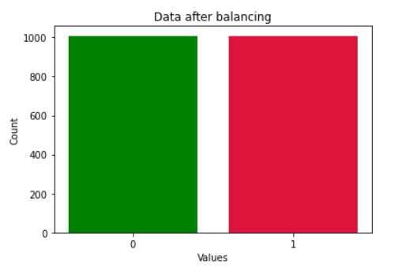
Balancing Data
Before balancing
After balancing

Slide 20
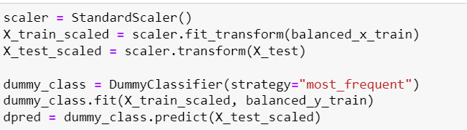
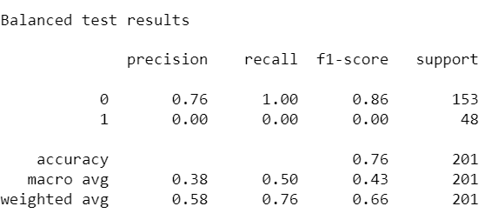
Dummy baseline
This is the dummy model I used which for some reason got a precision, recall and f1-score of 0 even though I scaled and used a balanced train dataset.

Slide 21
Models
I used Gradient Boosting Model since it is generally good for moderate to larger datasets.
I used Random Forest since it is good for moderate to larger datasets and usually performs better than Tree
I used SVM(Support Vector Machine) since it is more effective in high dimensional spaces and is relatively memory efficient.

Slide 22
Model building (Pipeline)
I used Pipeline so that I can chain together a sequence of steps such as scaling my data in putting it into my model.

Slide 23
Model Improvement(Kfold)
I then used KFold for cross-validation
The dataset is divided into n subsets or folds of approximately equal size
The model is trained n times, each time using n-1 folds as the training set and the remaining fold as the validation set.

Slide 24
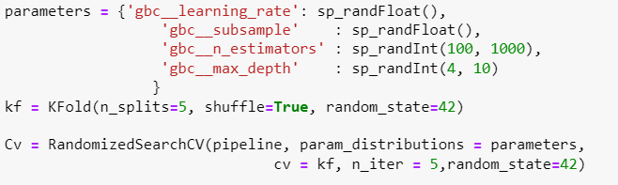
Model Improvement(RandomizedSearchCV)
I used RandomizedSearchCV as I have a lot of hyperparameters to tune.
It will choose a random set of hyperparameters to use and find out which set is the best.
Saves a lot of time

Slide 25
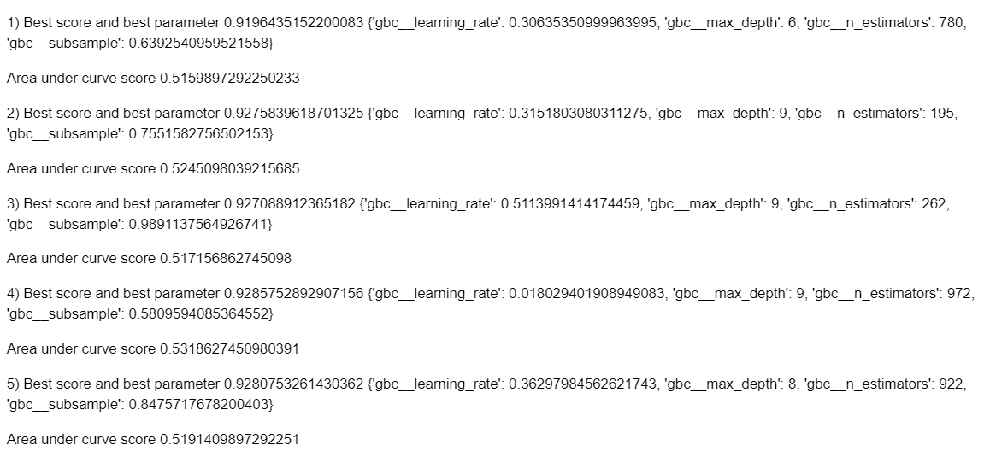
RandomizedSearchcv
Since I used Randomize Search, I rerun the code 5 times to make sure I get a good set of settings for my Gradient Boosting Model.

Slide 26
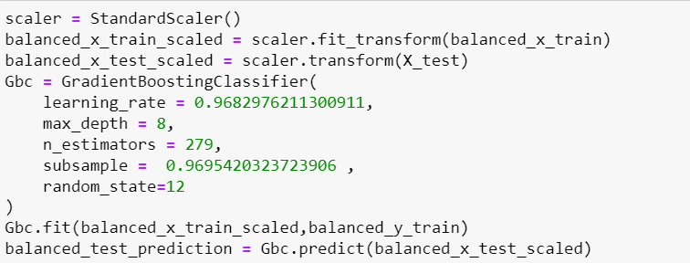
Final Model

Slide 27
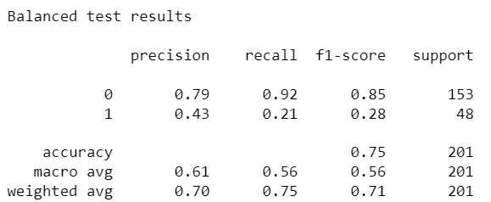
Model Evaluation (Gradient Boosting)
Gradient Boosting was my best model in terms of accuracy
My model got an accuracy of 0.75 which is moderately good.
The f1-score of outcome 0 is pretty good with a score of 0.85 but for outcome 1 is quite bad with a score of 0.28.
This means that my model have a high False Negative rate

Slide 28
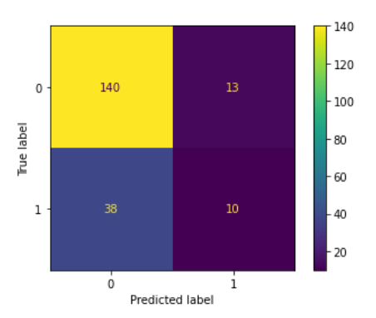
Confusion Matrix
My model predicted :
140 True Negatives out of 153
13 False Positive out of 153
38 False Negatives out of 48
10 True Positive out of 48

Slide 29
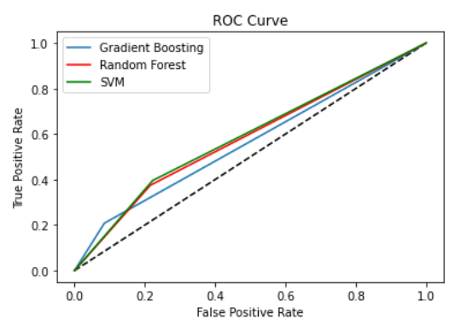
ROC Curve
This shows that my model performs better than the dummy baseline of 0.5 by a bit having an area under curve score of 0.562
Even though my Gradient Boosting’s accuracy is the best, SVM had the best area under curve of 0.587

Slide 30
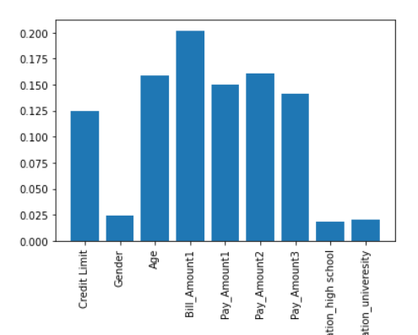
Model’s Feature selection
The model considers Gender and Education to be not very important while Payment History and Age to be very important
Age being important is surprising as I did not think it will be as important as payment history when predicting the outcome

Slide 31
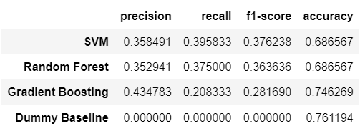
Dummy Baseline Comparison
From the table, I can see that my dummy has a higher accuracy than all my model as my model have a mean accuracy of 0.706 .
However, the dummy’s precision, recall and f1-score is 0 thus it means the dummy’s accuracy of 0.76 is actual worse than my models since the dummy only predicted the outcome of 0 which is not good from a technical or read-world standpoint.

Slide 32
Conclusion
In conclusion, the model thinks Gender and Education is not very important in predicting whether the customer will default payment.
The model is not very good in predicting the outcomes of 1
The model is only slightly better than random guessing

